Slide 1
Lab 5 Pre Lab
Shan Zhong

Slide 2


Slide 3
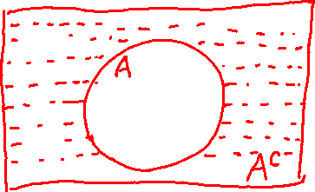


Slide 4
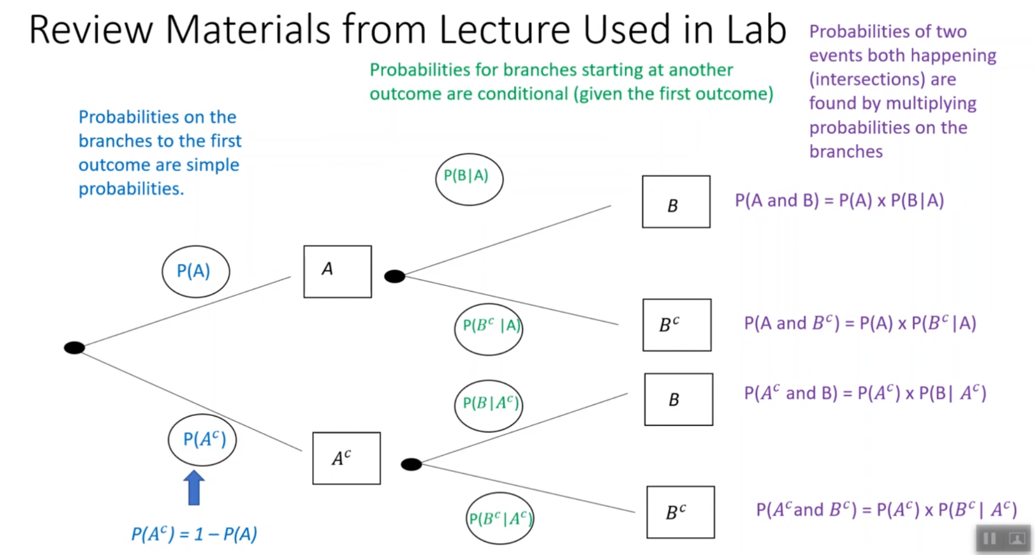

Slide 5
